Slide 1
Sequencing Bloopers
Simon Andrews
Tim Stevens

Slide 2

If you live long enough, you'll make mistakes. But if you learn from them, you'll be a better person.

Slide 3
Roll of “honour” (Lest we forget)
Andrew Keniry
Kristina Tabbada
Sebastien Smallwood
Tim Hore
Dimitra Zante
Gord Brown
Nicola Stead
Takashi Nagano
Steven Wingett
Ben Sidders
Alex Gutteridge
Phil Ewels
Felix Krueger
Julian Peat
James Hadfield
Noa Sher
Alastair Kerr
Stephen Turner
Leo Zeef
Robert Settlage
Deanne Taylor
Francesco Strozzi
Peter Cock
Jeanette McClintick
Hans-Rudolf Hotz
Sven Nahnsen
Pablo Moreno
Gos Micklem
Christina Cruz
Tamir Chandra
Hicham Bouabe
Stephen Frenk
Sergi Sayols Puig
Chris Penkett
Laura Biggins
Anoja Perera
Raoul Bonnal
Christel Krueger
Hema Bye-A-Jee

Slide 4
Categories of fail
Technical sequencer problems
Sequence repository problems
Data extraction problems
Odd sequence composition
My data doesn’t map / assemble
Software bugs
Mapped data QC
Biological common sense fails
Biological Interpretation problems

Slide 5
Technical sequencer problems

Slide 6
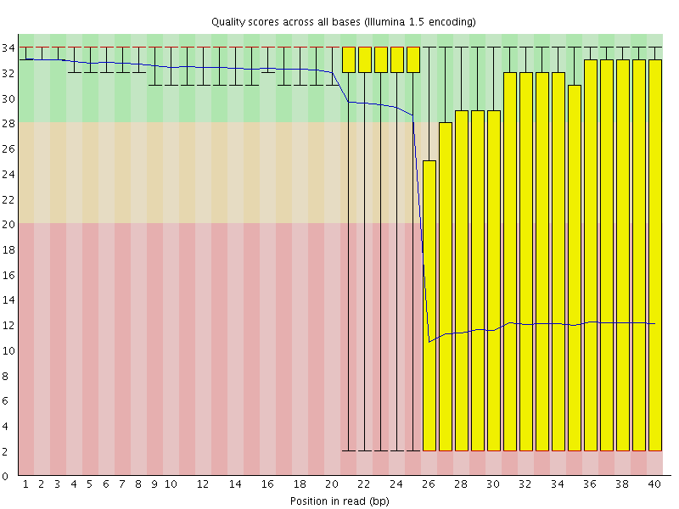
Manifold burst in cycle 26

Slide 7
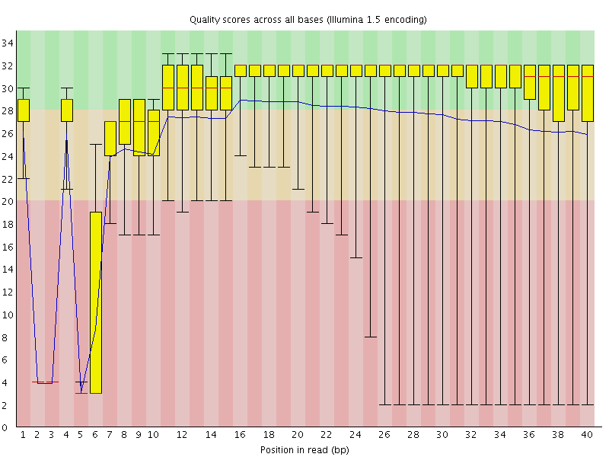
Specific cycles lost

Slide 8
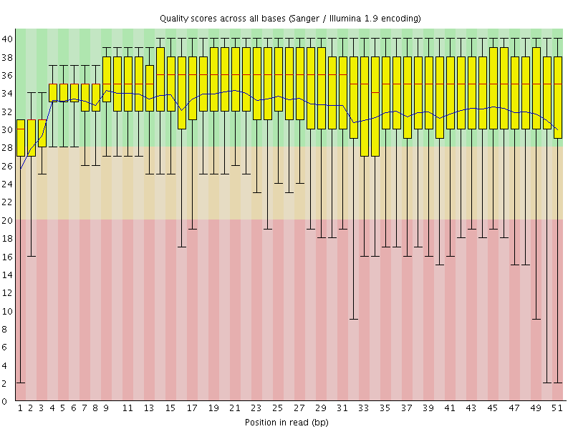
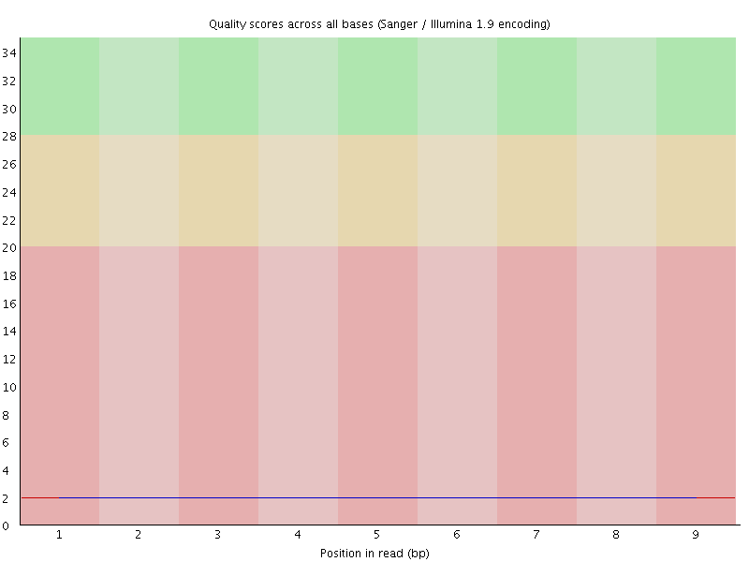
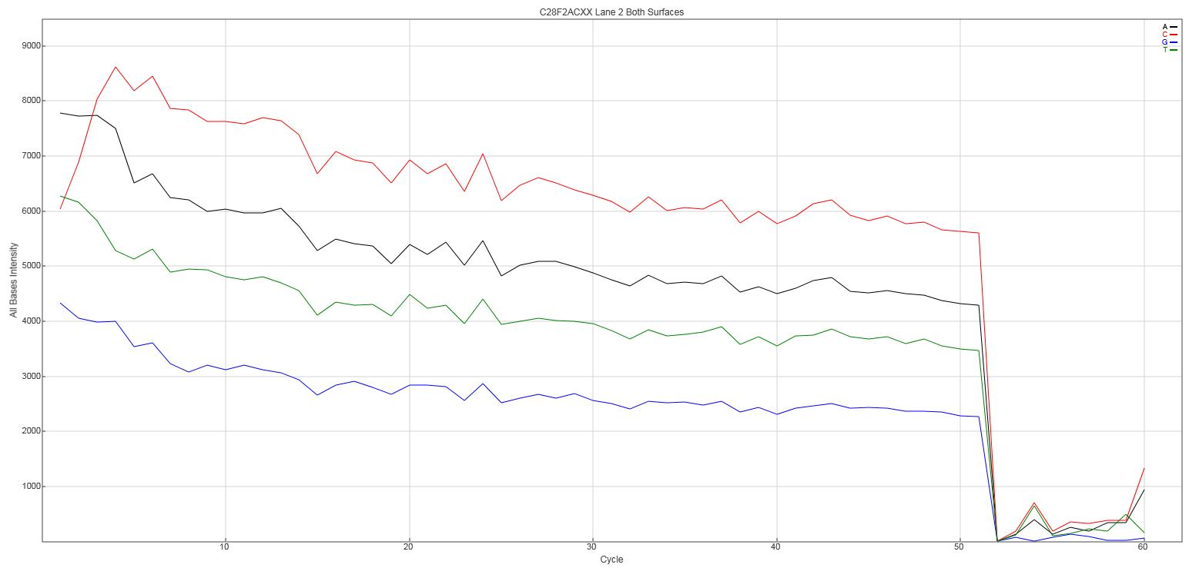
No priming /signal (Wrong adapters used)
Read 1
Read 2
(barcode)

Slide 9
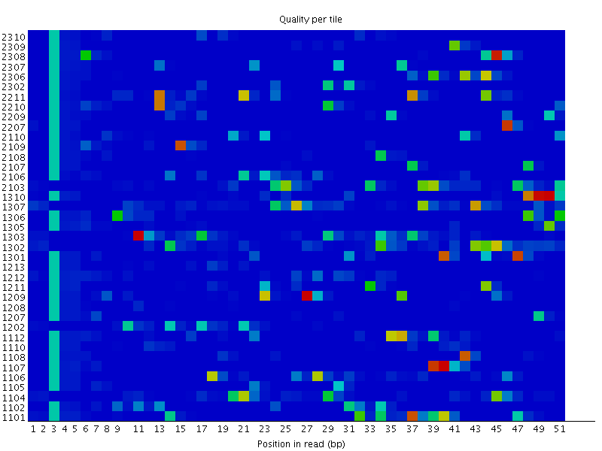
Tile Problems - Overclustering

Slide 10
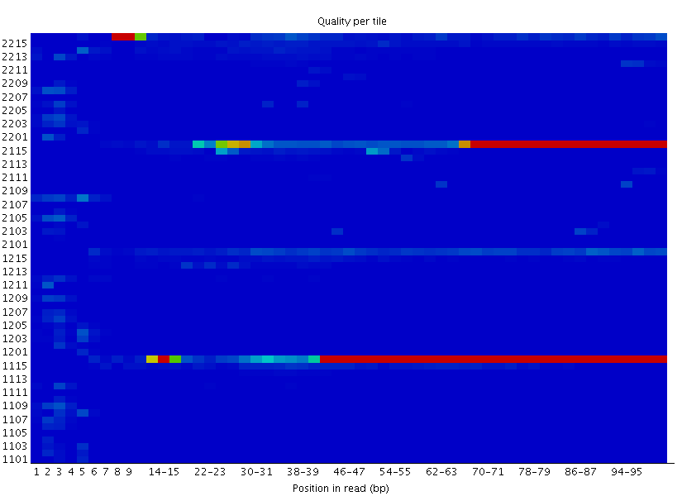
Tile Problems – Consistent tile fail

Slide 11
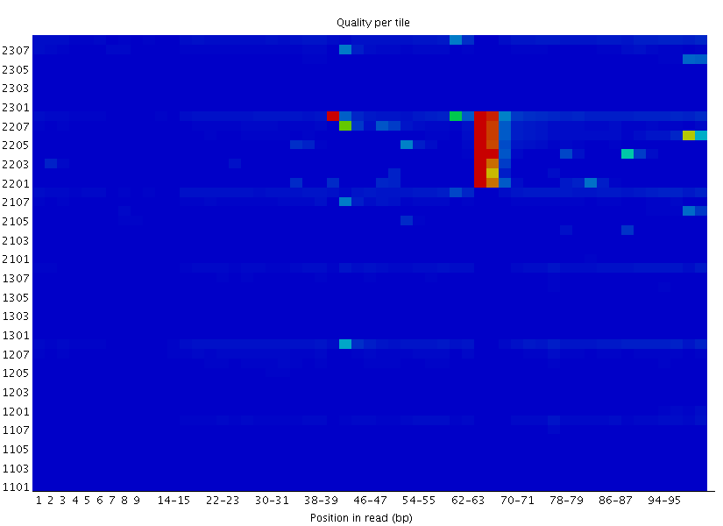
Tile problems – transient tile fail

Slide 12
Sequence Repository Problems

Slide 13
Incorrect SRA extraction
SRR443885 should be 2x50bp
NCBI metadata says it’s 2x75bp
When splitting with fastq-dump it makes:
==> SRR443885_1.fastq <==
@SRR443885.1 HWI-ST216_0305:5:1101:1210:2098 length=75
NCAGAAGACAGCCACAGNTTNNNNNNNNNNNNNNNNNNNNNNNNNNNNNNNNNNNNNNNNNNNNNNNNNNNNNNN
==> SRR443885_2.fastq <==
@SRR443885.1 HWI-ST216_0305:5:1101:1210:2098 length=25
NNNNNNNNNNNNNNNNNNNNNNNNN
With no warnings / errors!

Slide 14
Incorrect Phred Scores
“the NCBI SRA makes all its data available as standard Sanger FASTQ files
(even if originally from a Solexa/Illumina machine)”
Nucleic Acids Res. 2010 Apr; 38(6): 1767–1771.
SRR619473
Phred64 (Illumina)
Phred33 (Sanger)
Found LOTS of examples of this in the SRA

Slide 15
Selectively submitted data
SRR1769045 – Bisulphite sequencing (human)
Alignment efficiency 98.4%
CpG Methylation 39.5%
Non CpG Methylation 0.2%
Reads reported in supplemental 14,094,008
Reads found in GEO file 8,143,728

Slide 16
Data Extraction

Slide 17
Wrong barcode annotation
Expected barcode
Not expected barcode

Slide 18
Contaminated Barcode Stocks
Expected barcode
Not expected barcode

Slide 19
Odd sequence composition

Slide 20
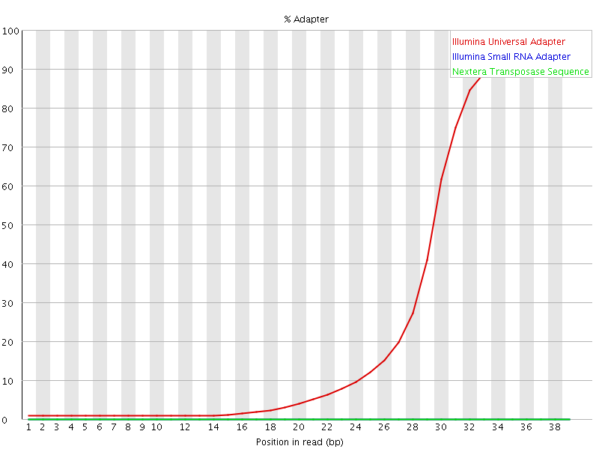
Read through adapter

Slide 21
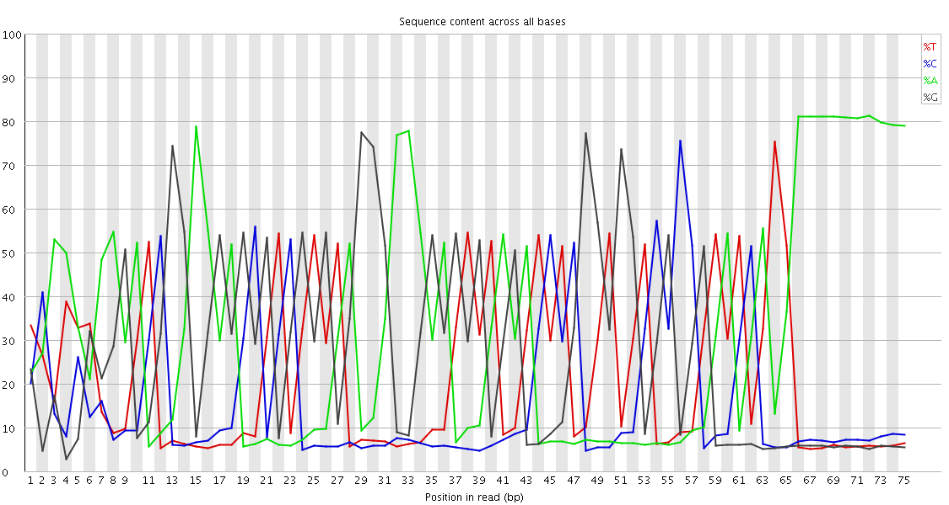
Adapter dimer overload
Sequence | % | Possible Source
CCTAAGGAGATCGGAAGAGCGTCGTGTAGGGAAAGAGTGTAGATCTCGGTGGTCGCCGTATCATTAAAAAAAAAA | 9.42 | Illumina Single End PCR Primer 1
TCAATGAAGATCGGAAGAGCGTCGTGTAGGGAAAGAGTGTAGATCTCGGTGGTCGCCGTATCATTAAAAAAAAAA | 7.30 | Illumina Single End PCR Primer 1
GAGACTCAGATCGGAAGAGCGTCGTGTAGGGAAAGAGTGTAGATCTCGGTGGTCGCCGTATCATTAAAAAAAAAA | 5.65 | Illumina Single End PCR Primer 1
gi|372098977|ref|NT_039624.8| Mus musculus chr16 GRCm38
CTGGAAGGGAGAAAAGTCCAAACATTCTGGCTCTAACTTCT
||||||||||||||||||||||||||||||||| || ||||
CTGGAAGGGAGAAAAGTCCAAACATTCTGGCTCCAAGTTCT
gi|372098992|ref|NT_039500.8| Mus musculus chr10 GRCm38
CTTTCTCTATCTGAATTATAAACAAAAGCACACAGGCCCGCTTACATTTACATGATAAAATGTGCACTTTG
|||||||||| || |||||||||||||||||||||||||||||||| ||||||||||||||| | ||||
CTTTCTCTATATGCATTATAAACAAAAGCACACAGGCCCGCTTACAGGGACATGATAAAATGTGAAATTTG
(Single-cell Hi-C)

Slide 22
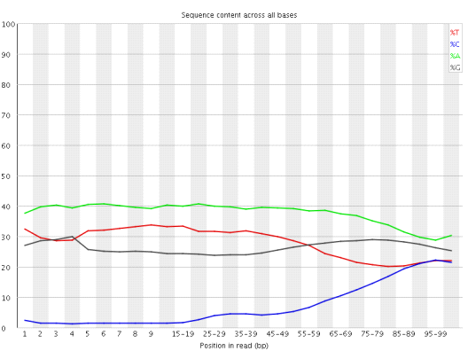
Positional Sequence Bias Application Specific – BS-Seq

Slide 23
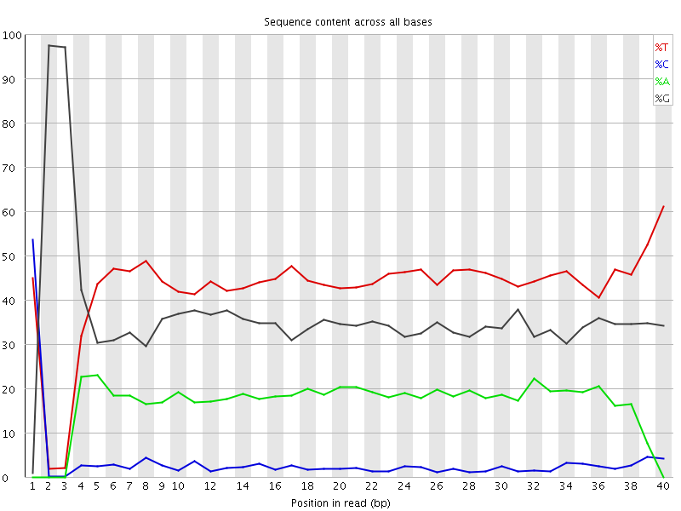
Positional Sequence Biases Expected - RRBS
Also reports of a ‘Chinese CRO’ whose RRBS libraries have the MspI sites missing due to
their proprietary and unexplained pre-processing

Slide 24
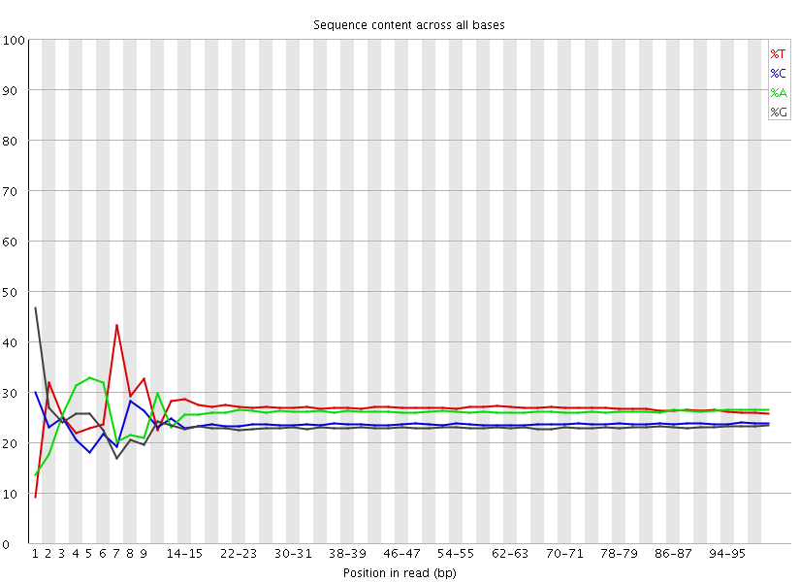
Positional Sequence Biases Unavoidable – RNA-Seq

Slide 25
Positional Sequence Biases Unexpected – Doubled Adapters

Slide 26
Overrepresented Individual Sequences
Adapter dimers
rRNA
Satellite sequences

Slide 27
My data doesn’t map well…

Slide 28
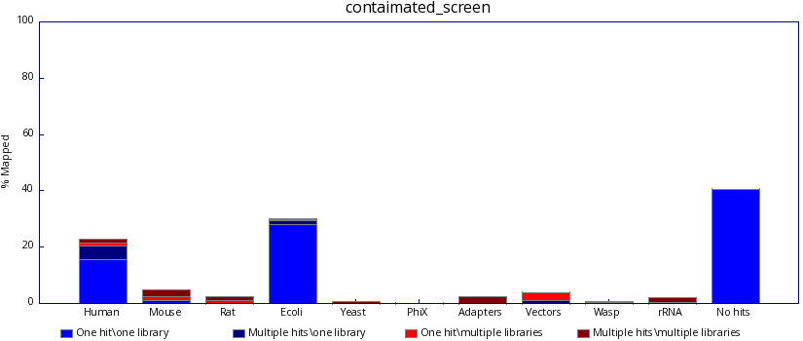
Contaminated with guessable sequence
www.bioinformatics.babraham.ac.uk/projects/fastq_screen

Slide 29
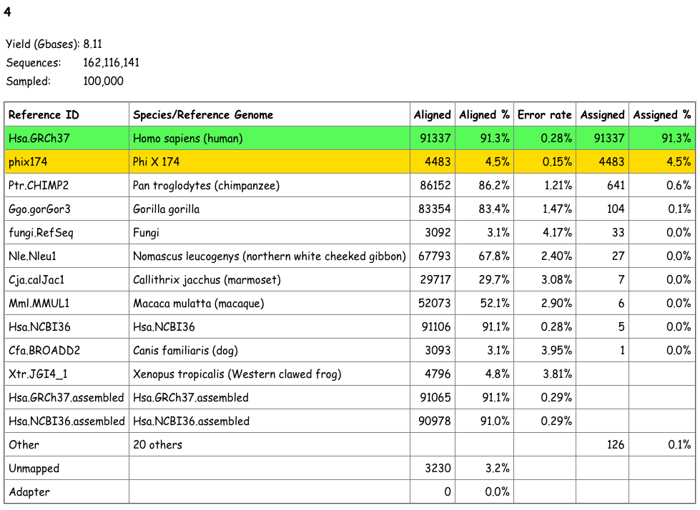
Contaminated with guessable sequence
CRUK Multi-genome alignment system (MGA)

Slide 30
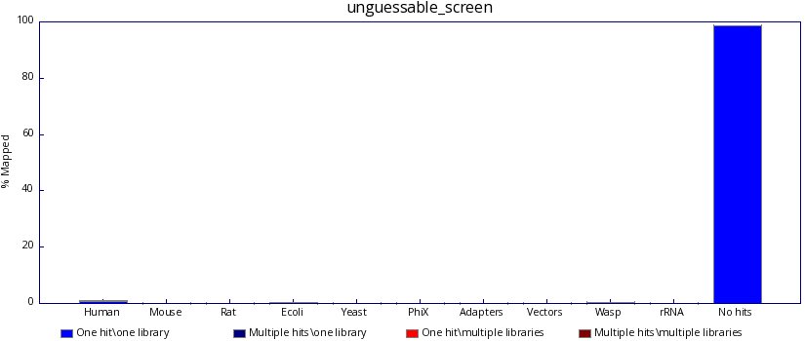
Contamination with unguessable sequence
>AF431889 AF431889.1 Acinetobacter lwoffii type IIs modification
Query: 1 cggtgagcaggcattagaaattgattttttagaaggtgtgttgaagaaactgggccgctt 60
|||||||||||||||||||||||||||||||||||||||||||||||||||||| |||||
Sbjct: 4661 cggtgagcaggcattagaaattgattttttagaaggtgtgttgaagaaactgggtcgctt 4720
>GQ352402 GQ352402.1 Acinetobacter baumannii strain AbSK-17 plasmid
Query: 1 ggtgagcagtggtttacatggttaattgaacaagacatcaacttctgcattcgtg 55
|||||||||||||||||||||||||||||||||||||||||||||||||||||||
Sbjct: 8213 ggtgagcagtggtttacatggttaattgaacaagacatcaacttctgcattcgtg 8159
>AF431889 AF431889.1 Acinetobacter lwoffii type IIs modification
Query: 1 acttgctgcgattaaagcagaaaaaacacttgctgaattgagtgct 46
||||||||||||||||||||||||||||||||||||||||||||||
Sbjct: 4484 acttgctgcgattaaagcagaaaaaacacttgctgaattgagtgct 4529

Slide 31
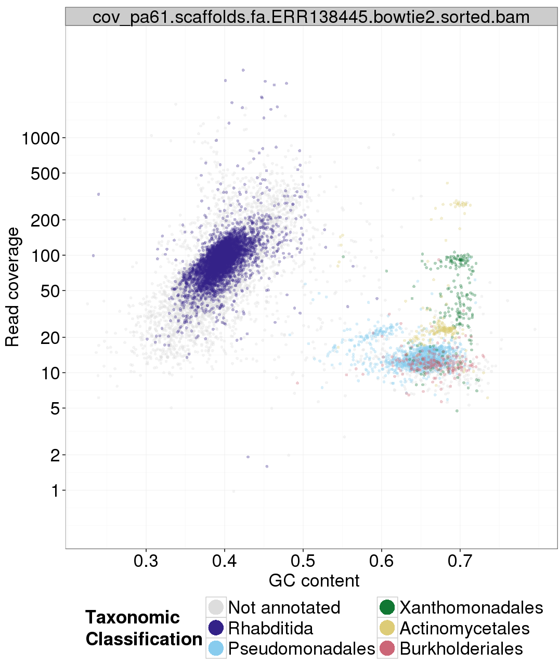
TAGC Plots
Assemble
Filter contigs
Plot %GC vs Coverage
Sample and blast
https://github.com/blaxterlab/blobology

Slide 32

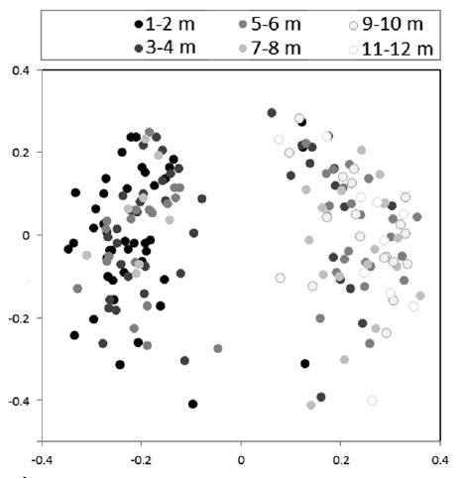
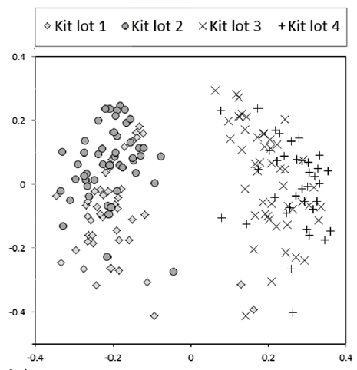
Reagent contamination
Molbio grade water is not the same as DNA free water – heat treated but DNA survives

Slide 33
Odd Paired Mapping
Non paired trimming
Unusual orientation
Chimeras

Slide 34
Software bugs…

Slide 35
Software Problems sratoolkit (1)
fastq-dump --split-files myfile.sra
Fails
fastq-dump.2.3.2 err: libs/vfs/resolver.c:790:VResolverAlgRemoteResolve: name not found while resolving tree within virtual file system module - failed to open ‘myfile.sra'
fastq-dump --split-files ./myfile.sra
Works

Slide 36
Software problems sratoolkit (2)
while($attempt < 6){
if(!system ("fastq-dump --split-files ./$file")){
warn "$file conversion successful\n";
last;
}else{
++$attempt;
warn "Failed $file on attempt $attempt, trying again\n";
}
}

Slide 37
Software problems Gzipping and concatenation
seq1.fq.gz
seq2.fq.gz
cat seq1.fq.gz seq2.fq.gz > all1.fq.gz
zcat seq1.fq.gz seq2.fq.gz | gzip -c > all2.fq.gz
Are all1.fq.gz and all2.fq.gz the same?
Answer: No
Some decompressors (gzip for example) will read all of the data from all1.fq.gz, but others (the java GZipInputStream class for example) will not and will silently
finish at the the end of the first concatenated file.

Slide 38
Software problems bcftools
Having duplicate sample names in a VCF file gives incorrect genotype calls for all samples in the file

Slide 39
Software problems Tophat
Running tophat with -g1 (only allow 1 multi-hit) causes every hit to be reported as a unique best hit (qual score 50) as it calculates uniqueness after the filtering, not before

Slide 40
Software problems [unnamed program]
Auto-detects a few different annotation formats
Provided with:
##gff-version 3
Completely corrupted the annotation and analysis
Needed
#gff-version 3

Slide 41
Mapped data QC

Slide 42
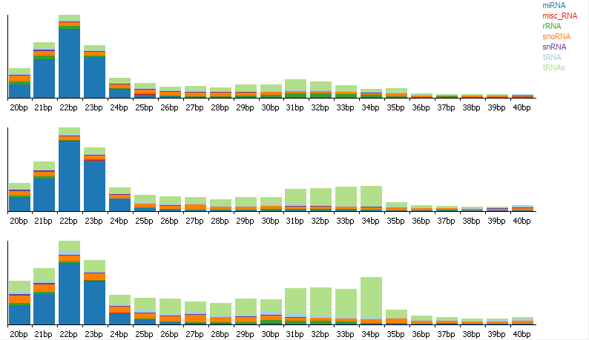
Application specific QC - smallRNA

Slide 43
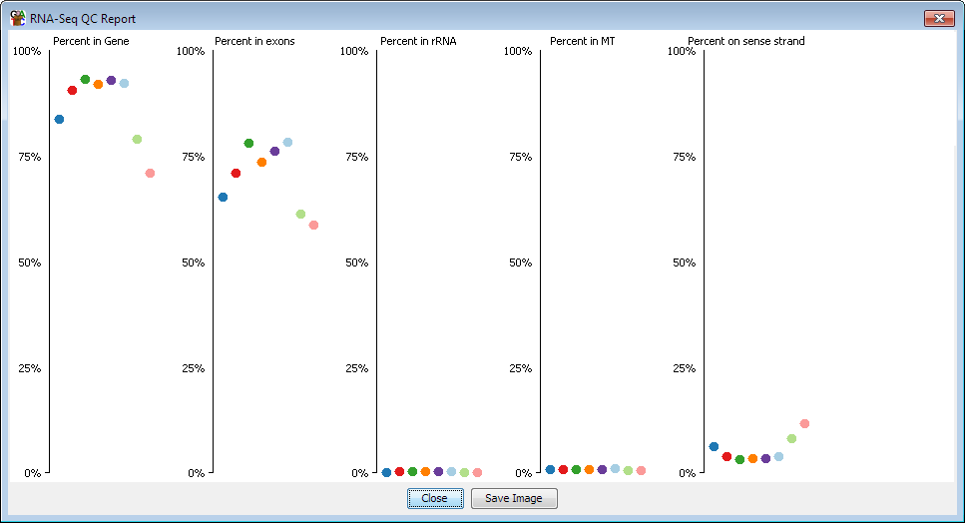
Application specific QC – RNA-Seq

Slide 44
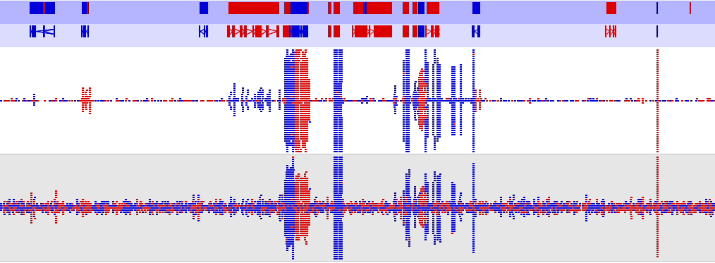
DNA Contamination

Slide 45
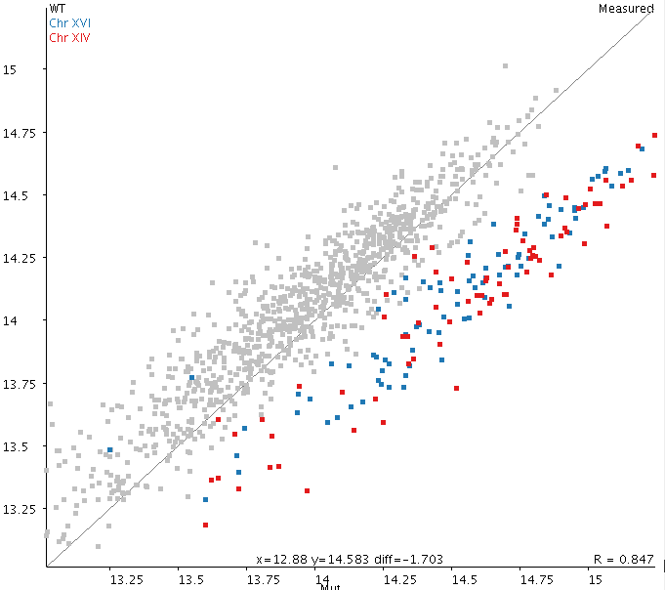
Copy number variation

Slide 46
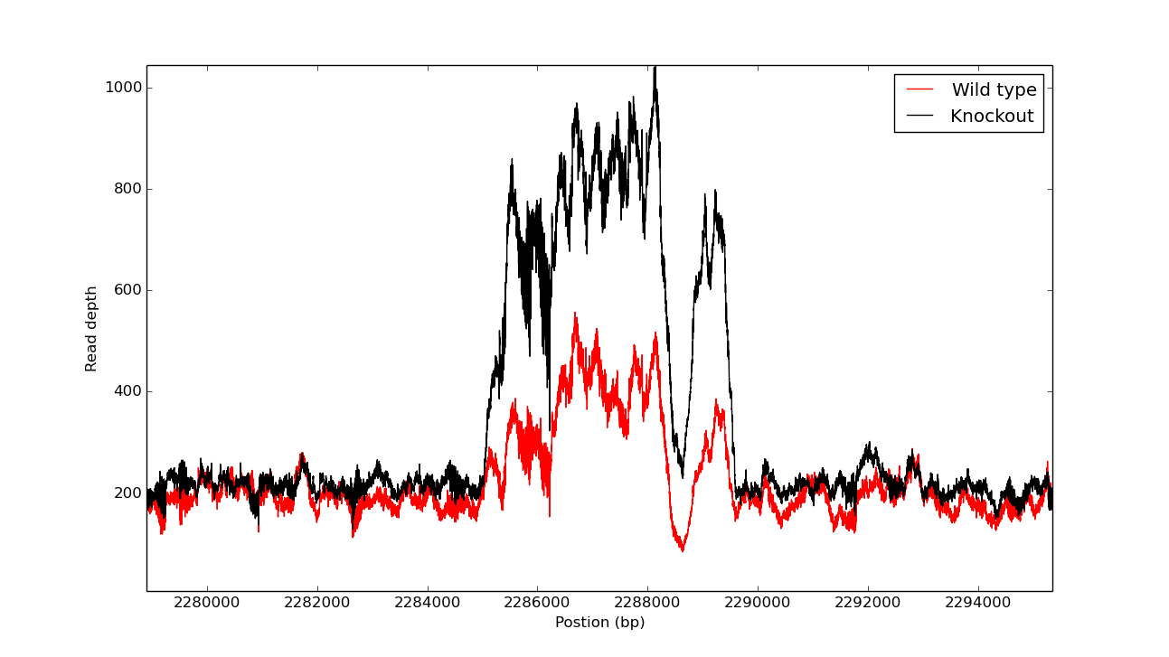
Read-depth/CNV
Two bacterial strains not only differ at the knockout point...

Slide 47
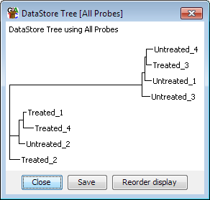
Sample Swaps

Slide 48
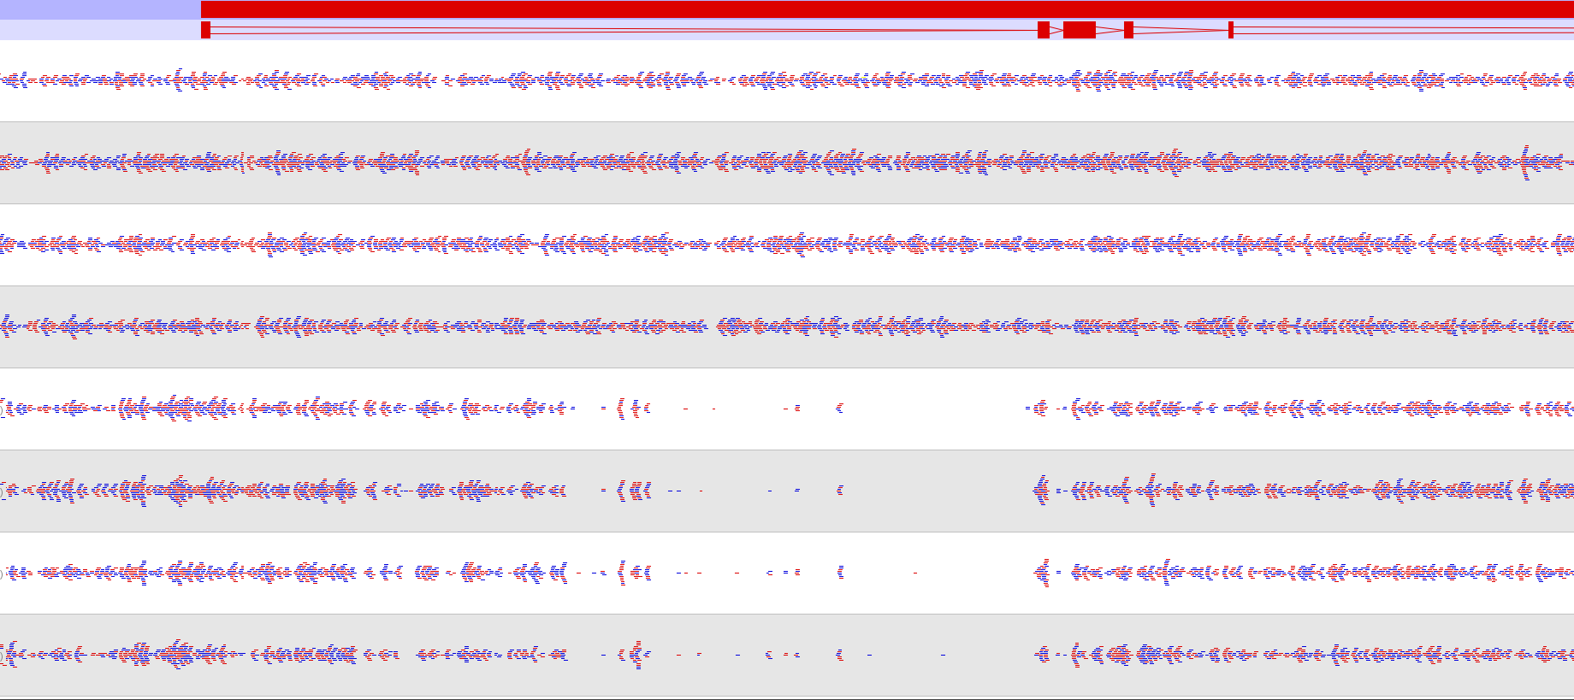
Sample swaps
KO1
KO2
KO3
KO4
WT1
WT2
WT3
WT4

Slide 49
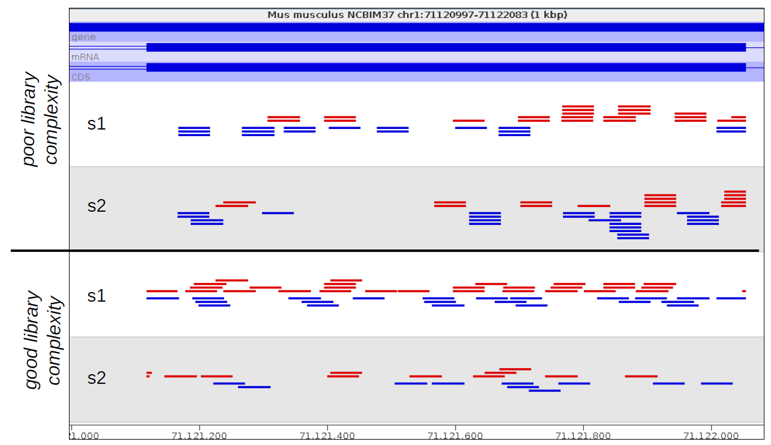
Duplication

Slide 50
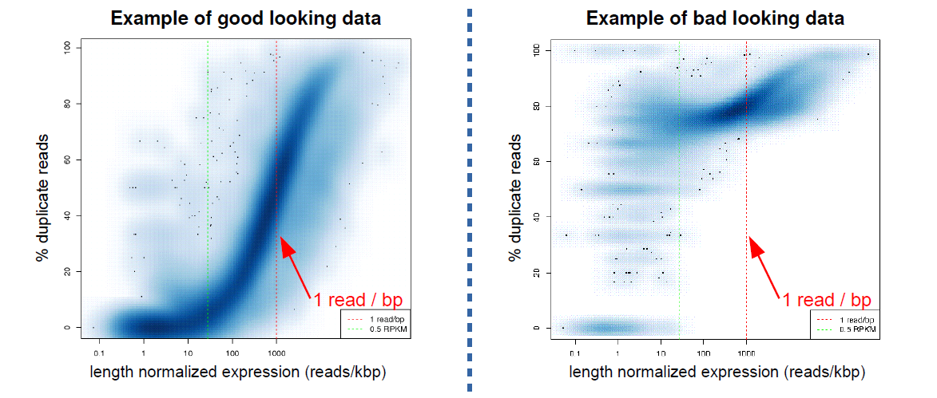
DupRadar
http://sourceforge.net/projects/dupradar/

Slide 51
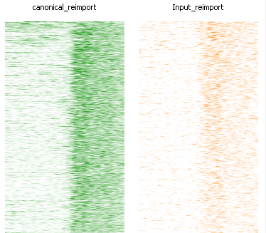
De-duplication and Repeat Enrichment
Real
R1
NR
R2
Mapped
R1
NR
R2
Deduplicated
R1
NR
R2
Peak callers (MACS for example) deduplicate internally, so you don’t have to consciously do this.
Only avoided by using uniquely mapped reads.
Repeat
Repeat

Slide 52
Biological common sense fails

Slide 53
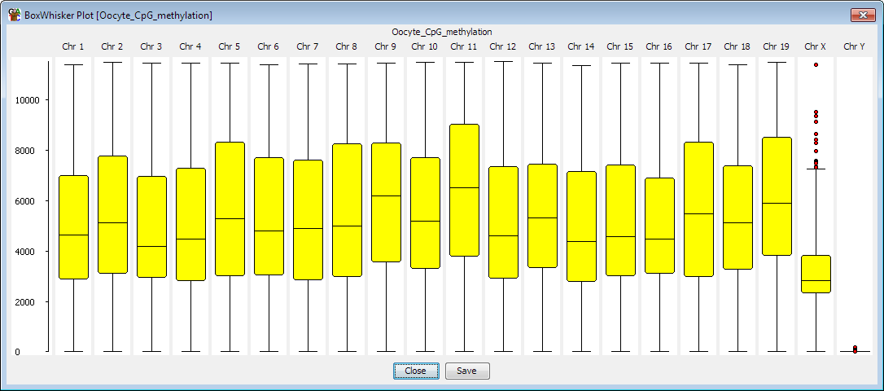
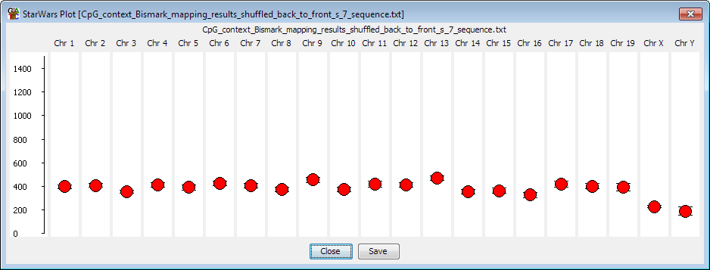
Common Sense – X/Y

Slide 54
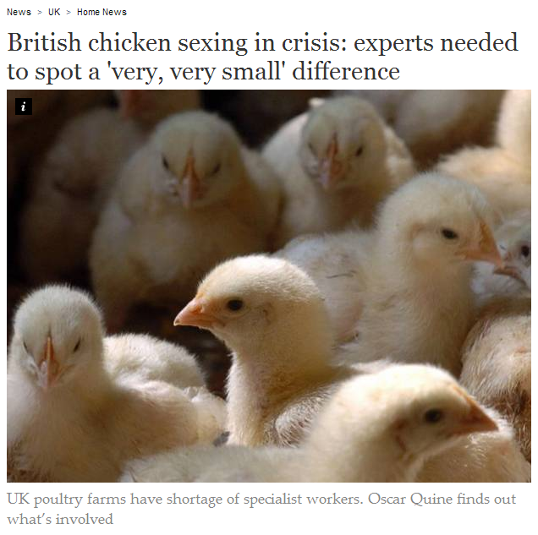
Even harder in chickens…

Slide 55
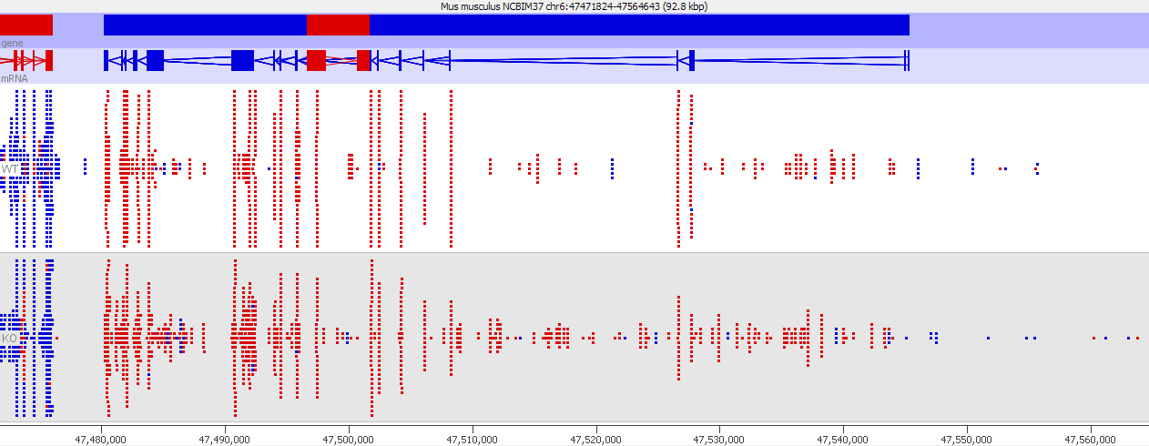
Common Sense – Knockouts
WT
KO

Slide 56
Biological interpretation problems

Slide 57
Biological Interpretation Common GO Errors
Original source of gene lists
Splice variation
Power to detect
Long genes vs short genes
CpG islands
Appropriate background
Treated liver cells enriched for liver GO categories
Technical artefacts

Slide 58
Biological Interpretation Problematic Genes
Titin, USH2A (big!)
Mucin, Mid1, Sfi1 (duplication events)
Olfactory receptors (big families)
Poorly annotated (RIKEN, EST, Gm123 etc)

Slide 59
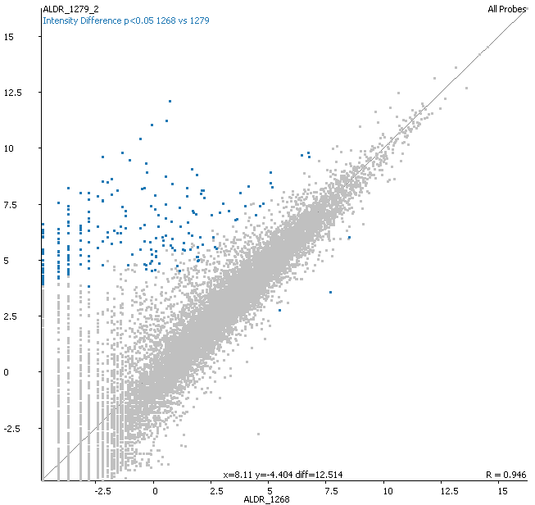
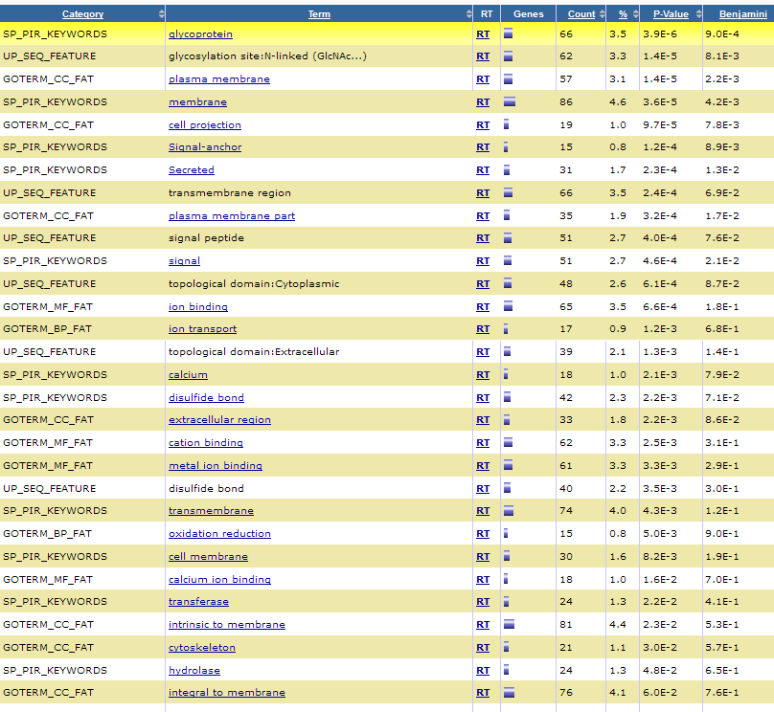
Biological Interpretation Membrane associated transcripts
Re-sequencing library = same result
Remaking library from RNA = changes gone

Slide 60
Over-represented GO categories

Slide 61
Software mentioned before
FastQ Screen
http://www.bioinformatics.babraham.ac.uk/projects/fastq_screen/
MGA
https://github.com/crukci-bioinformatics/MGA
FastQC
http://www.bioinformatics.babraham.ac.uk/projects/fastq_screen/
BamQC
https://github.com/s-andrews/BamQC
DupRadar
http://sourceforge.net/projects/dupradar/
TAGC Plots
https://github.com/blaxterlab/blobology

